Slide 1

Defensive Software Development
Matt Ruwe
Notes:
Dynamic Equilibrium
Evolutionary Architecture In .NET Supported by Roslyn Code Analysis
Why do we plan for the future? To anticipate changes because they are expensive when they arrive. What if our architecture allowed for changes?
Creating Resilient Software
Supercharge your application architecture
Creating software that tolerates changes well

Slide 2


About Me
Professional Software Developer for more than 20 years
Leader of the Omaha .NET User’s Group
Application Architect at Kiewit’s Technology Group
Married for 19 years
Father of 4 kids

Slide 3

Jerry

Slide 4
Problems in Software Development
Software is difficult to understand
Completed systems do not fulfil business needs
Completed systems are not performant
Problems are difficult to diagnose
Software is too difficult to change once released

Slide 5
Risks of not developing defensively
Software is difficult for other developers to understand
Runtime issues are difficult to troubleshoot
Architectures are prone to corruption
Business changes are difficult to implement

Slide 6
Evolutionary Architecture
Responding to change – architecting for change
Martin Fowler, Rebecca Parsons, Neal Ford
Two types of change
Technical
Domain
Change is inevitable – architect for the changes that we care about
Agile has pushed us toward a world where there is no big up-front design. We’ve probably gone too far.
Architect for change
Definition – An evolutionary architecture support guided, incremental change as a first principle along multiple dimensions.
Guided – we are not reactionary – our choices are explicit, not reactionary
Incremental Change – Does the architecture support the type of changes that we expect to have within our system

Slide 7
Defensive Driving
Defensives drivers demonstrate the following characteristics
Aware of their surroundings
Don’t expect drivers to behave the way they do
Continuously try to anticipate potential hazards
Are respectful of other drivers
Follow at a safe distance
Defensive features in cars
Seat belts
Safety glass
Multiple airbags
Lane keep
Automatic braking
Blind spot monitoring
Traction control

Slide 8
Defensive Development
Think about the developer that will have to maintain the code that you’re writing (you’re not writing the code for yourself, you’re writing it for someone else)
Try to anticipate the way the code might fail and give helpful exception messages explaining what action needs to be performed to remedy the problem
Write unit tests to ensure the code is behaving exactly the way you intend. Make sure you assert on items that might get broken by a future developer
When an error can’t be avoided, make sure it is contained to as small of an area of the application as possible.
Enforce architectural principles.

Slide 9
Roles
Software architects are responsible for building the infrastructure that developers will use. In the driving analogy, these are the roads, signage, and cars.
Software developers are building the business value. They are devising the route to take. They make sure the occupants of the car are comfortable and well informed during the trip.

Slide 10
Exceptions
Exceptions need to provide enough detail to help solve problems.
If the information is deemed security sensitive, it should be logged and referenced in the error message
Exceptions should provide insight about how to solve potential errors. This is especially useful in shared libraries.

Slide 11
Architectural Patterns
Patterns should define the pit of success. Developers should naturally fall into successful approaches because the architecture leads them this way
Projects references
Projects provide scoping for classes and provide protections due to limitations on circular references
Internal types
Types should have an internal accessibility when they aren’t intended to be used outside the scope of the assembly
Use new C# feature for nullable types

Slide 12
Code Generation
Use code generation where possible to eliminate that need to create boilerplate code

Slide 13
Code Analysis
Use code analysis to address any problems that aren’t covered by the previous topics

Slide 14

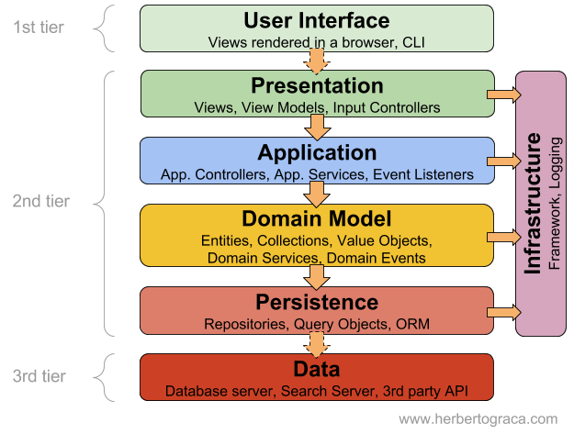
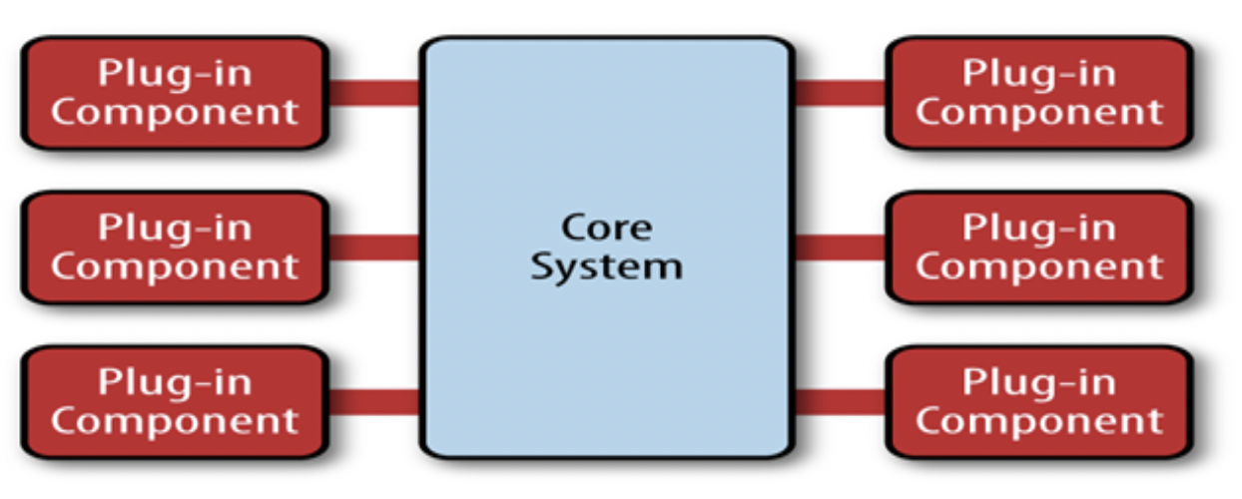
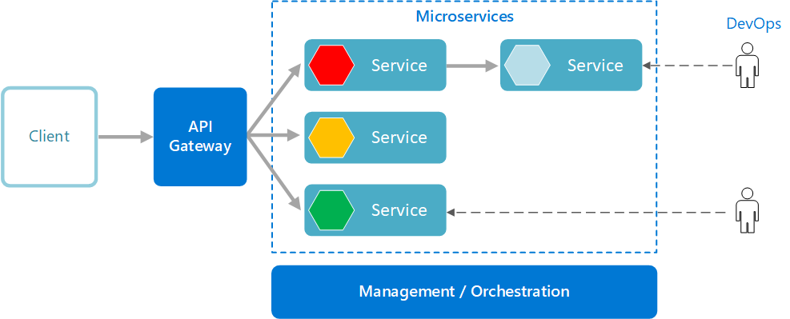
Types of Architectures
Big Ball of Mud
Layered Architecture
Micro Kernel Architecture
Microservices Architecture

Slide 15
Roslyn

